Slide 1
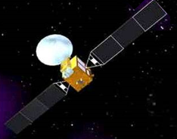







CNT Lab
工 程 认 识 ——北斗导航技术 BeiDou Navigation
王娜- Wang Na
Office： Engineering Training Center N207 – 工训北207
Email : lion_na987@buaa.edu.cn

Slide 2
Navigation Principal - 导 航 概 念
导 航：监视和控制载体从一个地方安全和高效的移动到另一 个地方的过程。
Navigation：Monitoring and Control the Carrier form one place to another safety and efficient.

Slide 3
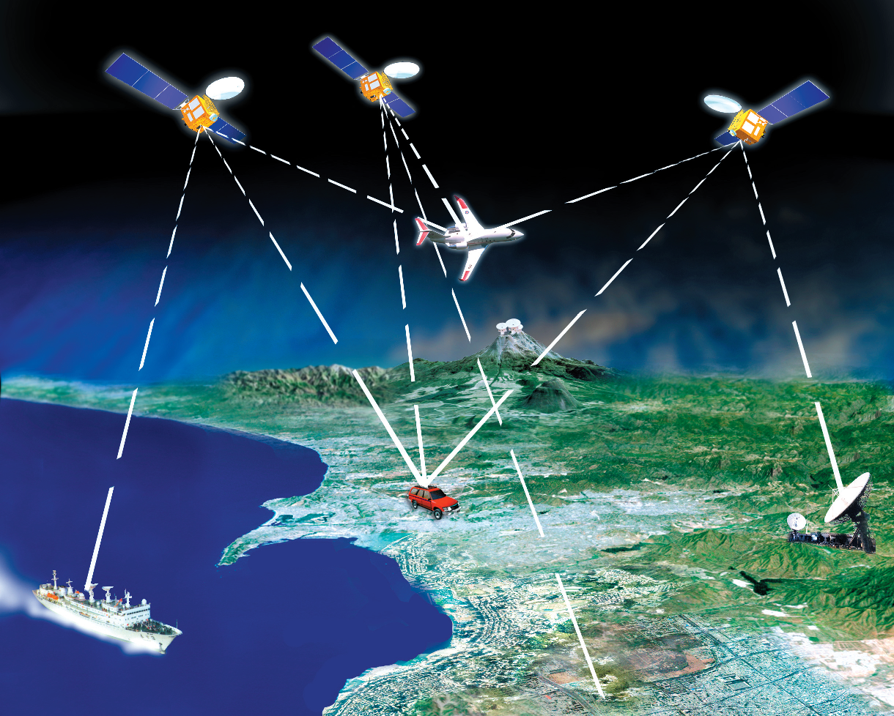
GNSS: Global Navigation Satellite System - 卫星导航
卫星导航系统：利用卫星发射无线电信号进行导航的系统
GNSS: Using Satellite transmit radio signal to navigation

Slide 4
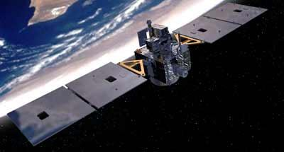
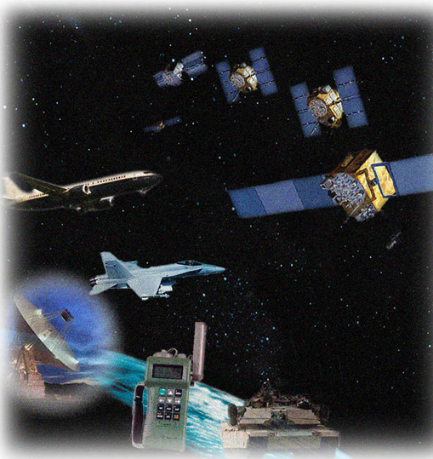
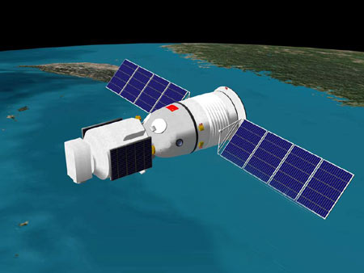
GNSS System Advantages - 卫星导航优势
GNSS
全 球 - Globe
全 天 侯 - All Weather
实 时 - Real Time
高 精 度 – High Accuracy
PVTA
GNSS比传统导航体制具有明显的优势！

Slide 5
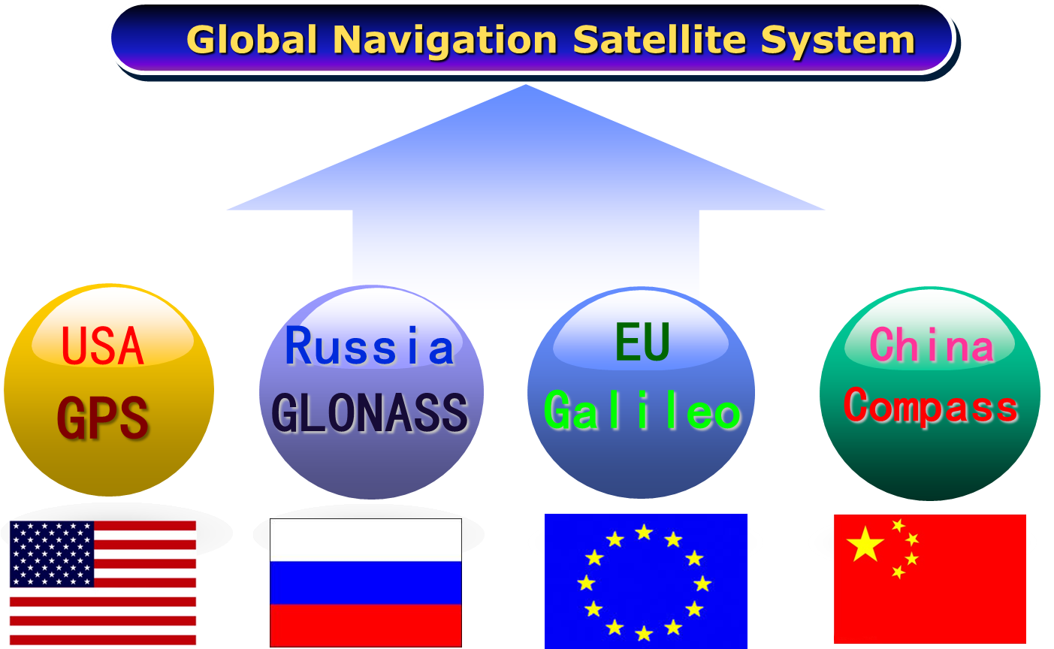
China
BD

Slide 6
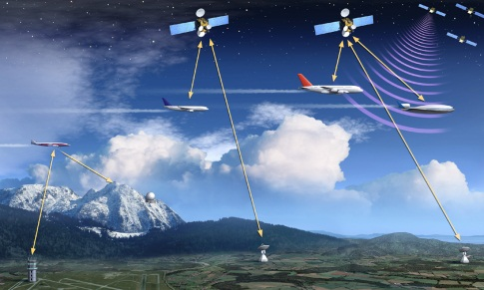
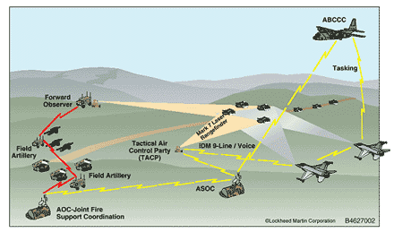
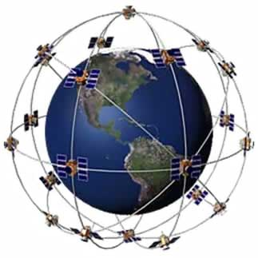
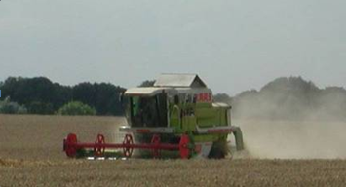

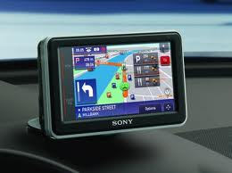

GNSS Application – 应用
交通管理Traffic Control
军事导航
Military Navigation
GNSS
Applications
精密农业
Precision Agriculture
时间服务
Time Service
个人导航
Personal navigation
测绘
Mapping & Survey

Slide 7
1. Key Elements – 基本要素
PVTA
Navigation System
导航系统
1
2
基本
要素
Carrier
载 体
3
4
Environment
环 境
Application Field
应用领域
5
6
Spacetemporal System
空时系统

Slide 8
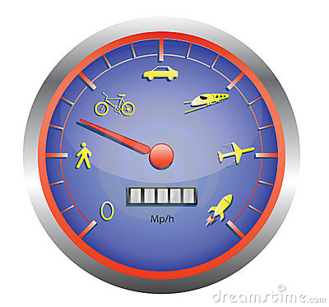
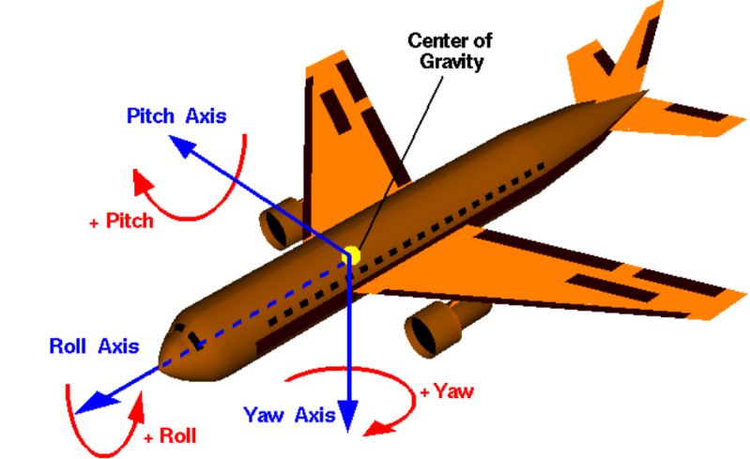
1. Key Elements – 基本要素
（1）PVTA
位置：经度、纬度、高度
Position：Longitude、Latitude、Altitude
速度：水平速度、径向速度
Velocity：Horizontal Velocity、Radial Velocity
姿态：航向角、俯仰角、横滚角
Attitude：Yaw、Pitch、Roll
时间：GPS时、原子时
Time：GPS Time、Atomic Time

Slide 9
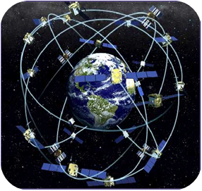
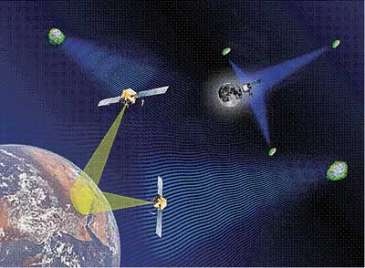
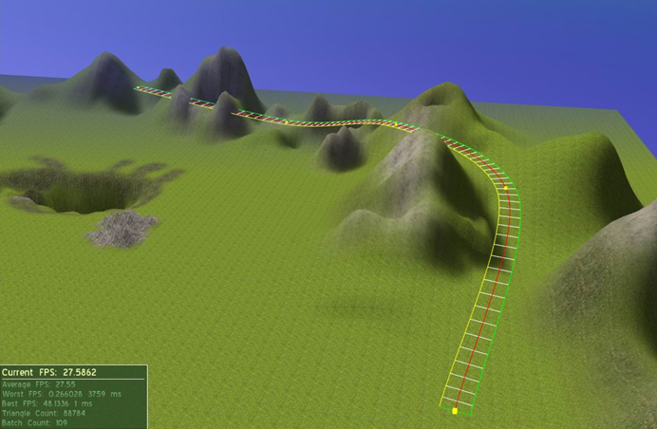
1. Key Elements – 基本要素
（2）Navigation system -导航系统
Radio navigation system - 无线电导航系统
Inertial navigation system - 惯性导航系统
Celestial navigation system - 天文导航系统
Terrain matching-navigation system - 地形匹配导航

Slide 10
1. Key Elements – 基本要素
（2）Navigation system -导航系统
Radio navigation system - 无线电导航系统
Inertial navigation system - 惯性导航系统
Celestial navigation system - 天文导航系统
Terrain matching-navigation system - 地形匹配导航

Slide 11
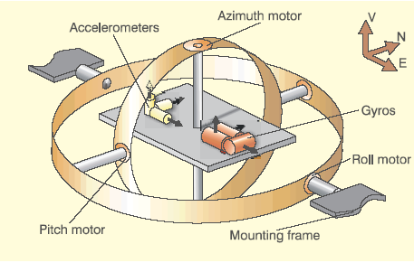
(1) Inertial Naviigation System - 惯性导航系统
An inertial navigation system (INS) is a navigation aid that uses a computer, motion sensors (accelerometers：加速度计) and rotation sensors (gyroscopes：陀螺) to continuously calculate via dead reckoning the position, orientation, and velocity of a moving object without the need for external references.
The INS is initially provided with its position and velocity from another source(like GNSS).

Slide 12
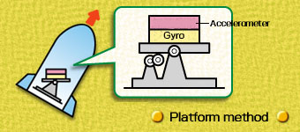
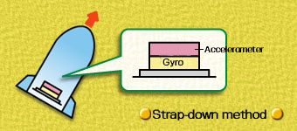
(1) Inertial Naviigation System - 惯性导航系统
Platform method
平 台 惯 导
Strap-down method
捷 联 惯 导
It is more technically advanced than the platform method and lends itself to low-weight, compact, low power-consumption, and highly accurate applications, but it need high computational capability.
This method maintains the IMU in the same attitude relative to the surroundings.
Notes:
恒星眨眼睛，因为距离远，受空气扰动
行星不眨
卫星动

Slide 13
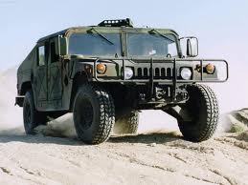
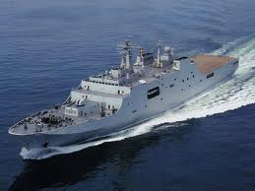
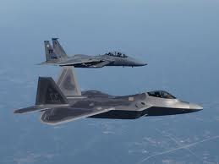
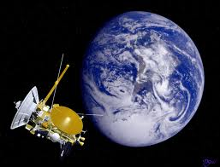
1. Key Elements – 基本要素
（3）Carrier - 载体
Land Vehicle - 陆地运载器
Voyage Vehicle - 航海运载器
Aircraft - 航空飞行器
Spacecraft - 航天飞行器

Slide 14
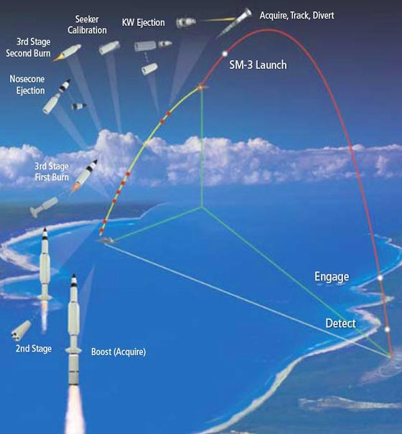
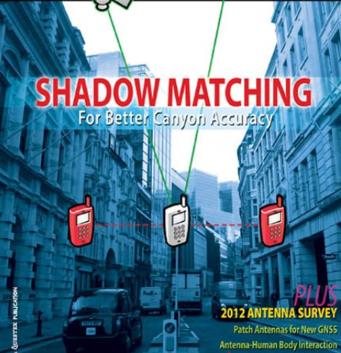
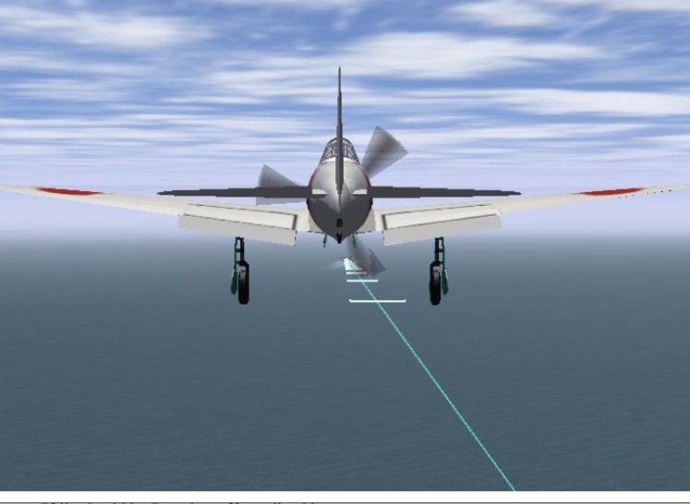
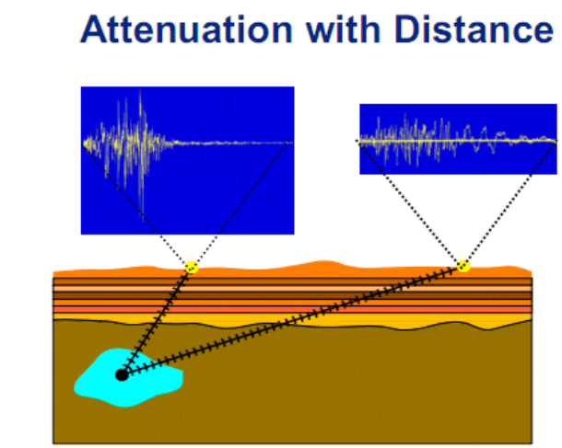
1. Key Elements – 基本要素
（4）Enviroment - 环境
Interrupt - 干扰
Dynamic - 动态
Obstruct -遮蔽
Attenuation -衰减

Slide 15
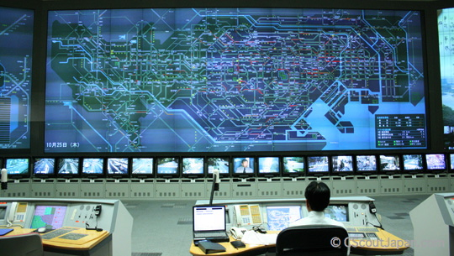
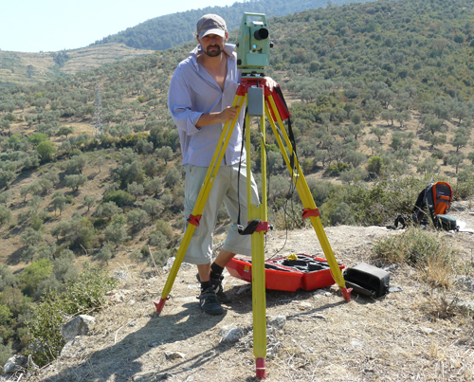
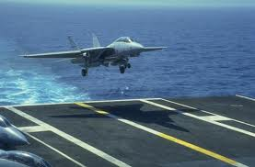
1. Key Elements – 基本要素
（5）Application - 应用领域
Landing - 着陆着舰
Traffic Control -交通管理
Mapping & Search and Rescue -测绘及搜救

Slide 16

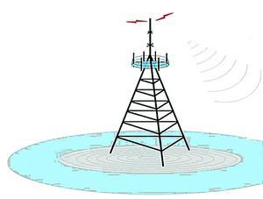
(2) Radio Naviigation System–无线电导航系统
R = c·∆t/2
Basic principle of RNS - Active

Slide 17
(2) Radio Naviigation System–无线电导航系统
R = c·∆t
Basic principle of RNS - Passitive

Slide 18
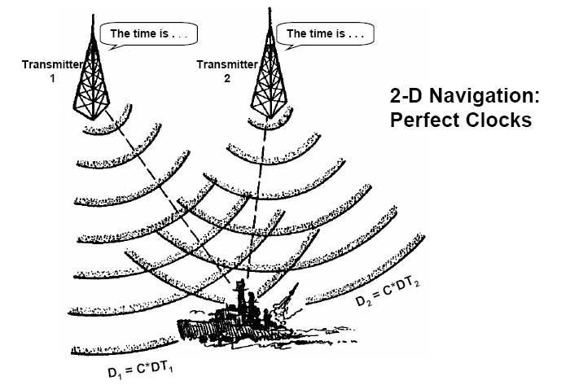
(2) Radio Naviigation System–无线电导航系统
Hyperbolic positioning – 双曲线导航

Slide 19
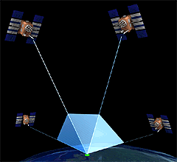
(2) Radio Naviigation System–无线电导航系统
GNSS – Four satellite to get four parameters(x,y,z and t)

Slide 20
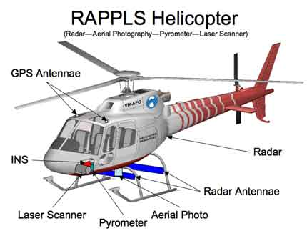
(6)Integrated Navigation System -组合导航系统

Slide 21
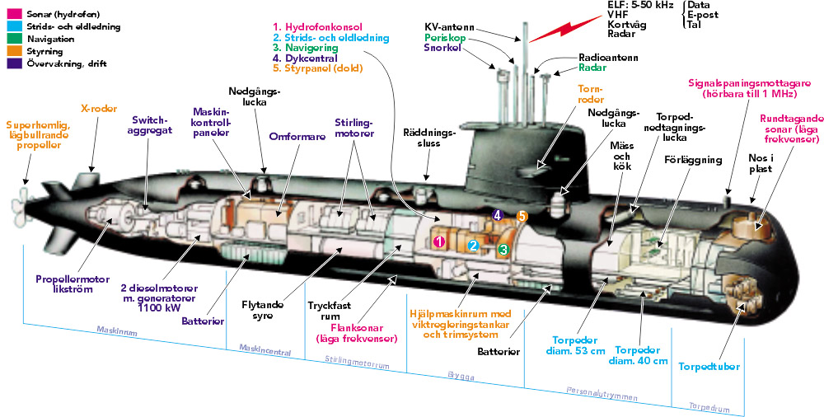
(5)Integrated Navigation System -组合导航系统
Submarine Navigation Systems- Swedish Gotland Class：瑞典哥特兰级

Slide 22

Thanks

